Slide 1
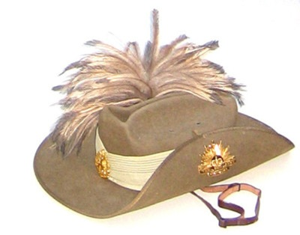
ANZAC DAY
On ANZAC Day, 25th April each year, we remember the brave men and women who have served our country in times of war.

Slide 2
Medals
People who have defended our country get special medals. These medals are proudly worn on ANZAC Day when we remember all the people who have died or suffered in wars so that we can live freely today.
To be free means that we can do things like go where we want to go, live where we want to live, own our own things, have food to ear, a job to earn money and act as we want to act. In some countries people are not allowed to do these things.

Slide 3
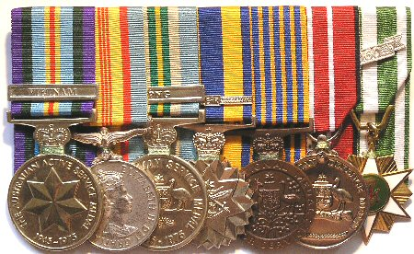
Medals

Slide 4
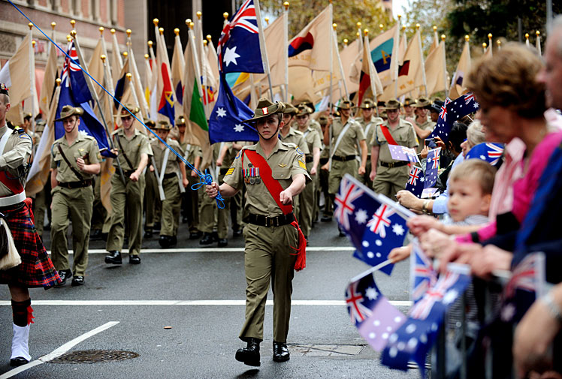
Parades
On ANZAC Day we show our thanks to people who have fought for our country. It is such a special day that it has been made a holiday so that people can go to the parade in their towns. We can wear ANZAC day badges and wave Australian flags to show how proud we are.

Slide 5
Ode
The ode is part of a special poem that is said during the ANZAC Day Service.
They shall grow not old, as we that are left grow old;
Age shall not weary them, nor the years condemn.
At the going down of the sun and in the morning,
we will remember them.
Lest we forget.

Slide 6
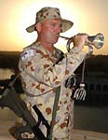
The Last Post
The Last Post is played on ANZAC Day to remind us of the many soldiers killed or hurt during the war.

Slide 7
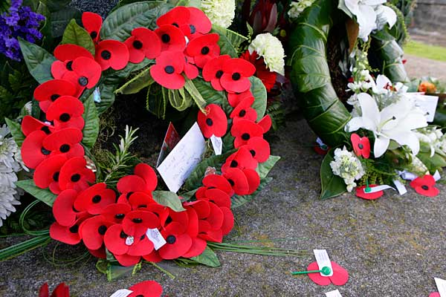
Red Poppies
On ANZAC Day flowers and wreaths of red poppies are laid at the bottom of war memorials as a way of saying we have remembered these brave people.
A war memorial is a place that honours all those people who have died in wars.

